Slide 1
ThreeFish Cipher
Bolous AbuJaber

Slide 2
Historical Background

Slide 3
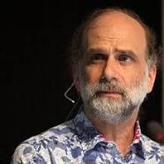
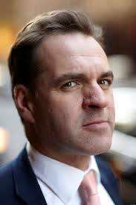
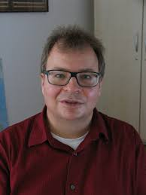
Designers
And more….
Bruce Schneier
Niels Ferguson
Stefan Lucks
is an American cryptographer, computer security professional, privacy specialist and writer.
is a Dutch cryptographer and consultant who currently works for Microsoft
Researcher in the fields of communications security and cryptography. Lucks is known for his attack on Triple DES,

Slide 4

NIST Competition
ThreeFish was designed in 2008 as part of the Skein Hash function.
Original Paper: https://www.schneier.com/academic/paperfiles/skein1.3.pdf
It was introduced in the National Institute of standards and technology competition as a candidate for SHA-3.

Slide 5
Predecessors
ThreeFish is derived from two preceding algorithms: Blowfish and Twofish, both designed by Bruce Schneier, and others.
Blowfish is considered unsafe now, the designers encourage using TwoFish or Threefish for encrypting texts.
At this point, though, I'm amazed it's still being used. If people ask, I recommend Twofish instead. — Bruce Schneier, Blowfish's creator, 2007

Slide 6
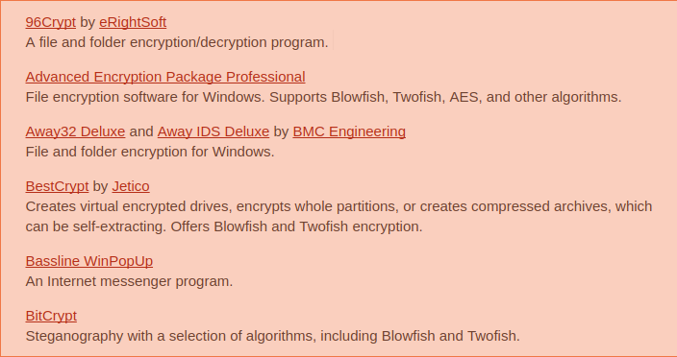
Popularity and Applications
ThreeFish and all of its predecessors are Unpatented and uncopyrighted.
Reported to be widely used in commercial applications and tools due to it being free.
CryptoCat: a NetCat variant uses TwoFish for Encryption, and many more...

Slide 7
Characteristics

Slide 8
General Idea
Symmetric key Encryption
Lots of simple encryption rounds
Uses Tweak words to confuse the key
Each round uses only simple bitwise operations on the input.
Does Not use S-boxes, or other table lookups in order to avoid cache timing attacks
Designed with performance in-mind, Especially for 64-bit Systems.

Slide 9
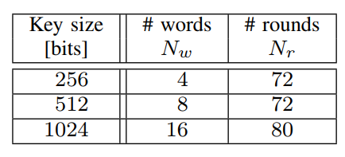
Three Different Configurations
Blocks and sizes
Wide-Block Cipher
Three block Sizes: 256, 512, 1024
64 bit Words
Rounds: The algorithm has three rounds configurations according to Block-Size
Key: The Key always has the same size as the Input Block.

Slide 10
Performance
Very Fast Software and Hardware Implementation
Performance is a key consideration in designing the cipher
Threefish-512 encrypts data at 6.1 clock cycles per byte on 64-bit machine
Threefish-1024 encrypts data at 6.5 clock cycles per byte

Slide 11
The Algorithm

Slide 12
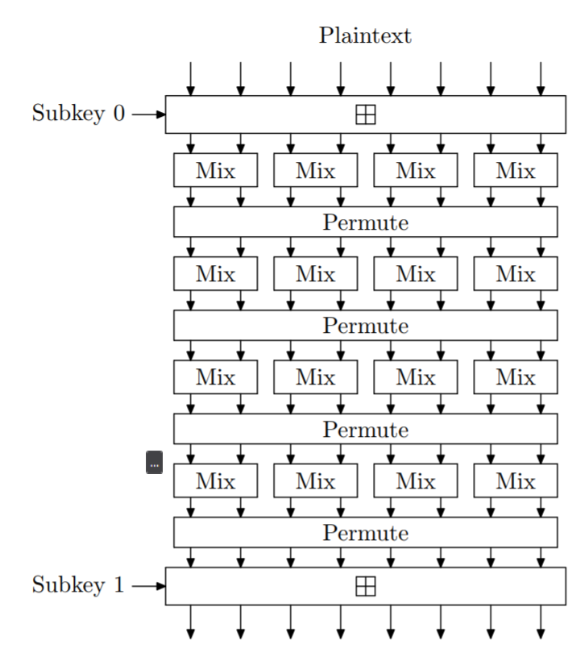
Overview of ThreeFish-512
Each of ThreeFish-512’s 72 rounds consists of four MIX functions followed by a permutation of the eight 64-bit words.
A subkey is injected every four rounds.
The word permutation, ”Permute,” is the same for every round; the rotation constants are chosen to maximize diffusion and repeat every eight rounds

Slide 13
Key Preparation
Threefish uses Nr/4 + 1 different round keys.
To calculate these keys an additional keyword Kn is appended to the original key words K0, K1, … Kn-1
T0, T1 are called tweak words, they are added to the last two keys.
The purpose of the seemingly arbitrary constant C240 is to frustrate some attacks that take advantage of the relationship between Kn and the other keywords.
The keys are applied every 4 rounds

Slide 14
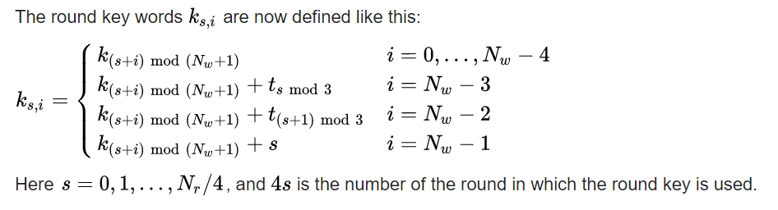
Key Schedule

Slide 15
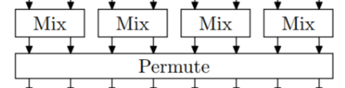
A Single round
In a single round we do two main operations: Mix and Permute
Mix provides bit-level diffusion and permutation
While Permute swaps between different blocks
This round is applied 72 or 80 times according to the algorithm’s configuration

Slide 16
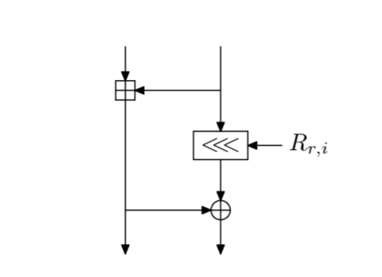
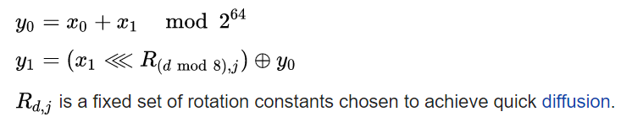
Mix Function
The basic encryption block in the cipher
Takes 2 64-bit words (X1, X1)
Outputs two 64-bit Words (Y0, Y1)

Slide 17
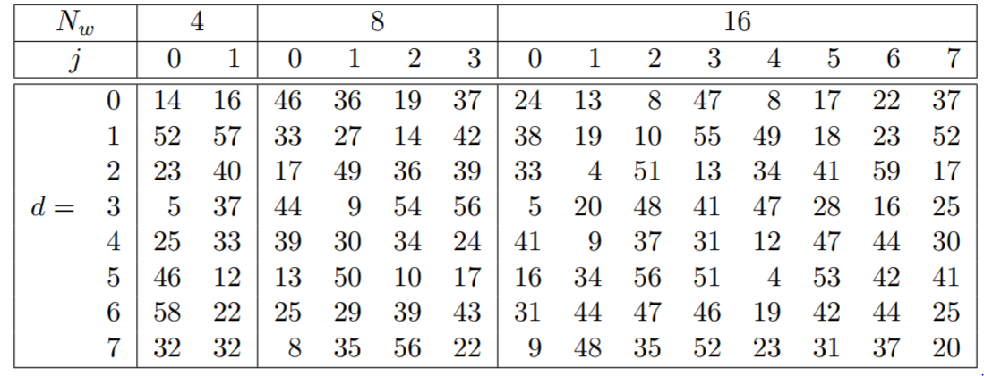
The Mix Rotation
This table provides constant rotation amounts for every Round/Word

Slide 18
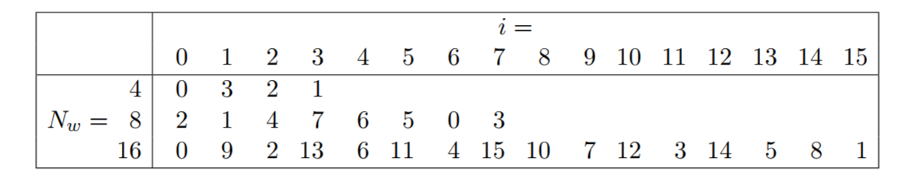
Permute
The permutation step swaps the positions of the words according to a constant pattern.
Bit-level permutation is not achieved in this step, but this is not necessary since the MIX functions provides bit-level permutations in the form of bitwise rotations.

Slide 19
Decryption
The Threefish decryption operation is the obvious inverse of the encryption operation.
Subkeys are used in reverse order
each round consists of applying
inverse word permutation
followed by the inverse MIX functions.

Slide 20
Attacks

Slide 21
Attacks
ThreeFish has a large security margin, and can be safely used for encryption.
Threefish has been tweaked twice. The first two versions were vulnerable to rotational cryptanalysis up to 57 rounds.
The last version of Threefish is quite strong. Even in weak models the best attacks hardly penetrate half of the cipher.

Slide 22
Implementations

Slide 23
Python
PySkein
https://pythonhosted.org/pyskein/threefish.html
An Implementation of the Skein hash function and the ThreeFish algorithm.
Can be Installed using pip install pyskein

Slide 24
